Slide 1
Monterey County 2010 General Plan Consistency
FORA Board of Directors
October 11, 2013

Slide 2
Background
2001 Fort Ord Master Plan
  Applied Base Reuse Plan policies
  Found consistent by FORA Board.
2010 Monterey County General Plan
  Minor changes from 2001 version
County adopted consistency finding
FORA Reassessment Effort

Slide 3
Consistency
Purpose of the Fort Ord Master Plan
Minor changes made in consultation with FORA staff
  Land Swap Agreement
  Missing policies from 2001
  Updates to reflect current conditions
Required Policies have been addressed.

Slide 4
Consistency v. Changes/Implementation
Fort Ord Master Plan is consistent with the Fort Ord Reuse Plan
Comments suggest:
  Deny consistency determination until changes are made; or
  Deny consistency determination due to a lack of plan implementation.
Focus is consistency between adopted plans.

Slide 5
Public Comments
Alleged Inconsistencies:
  The Land Swap Agreement
  Water Supply
  Discrepancies between General Plan language and Reuse Plan language
  Discrepancies between the General Plan Land Use Map and the Reuse Plan Land Use Map; and
  Lack of Implementation

Slide 6
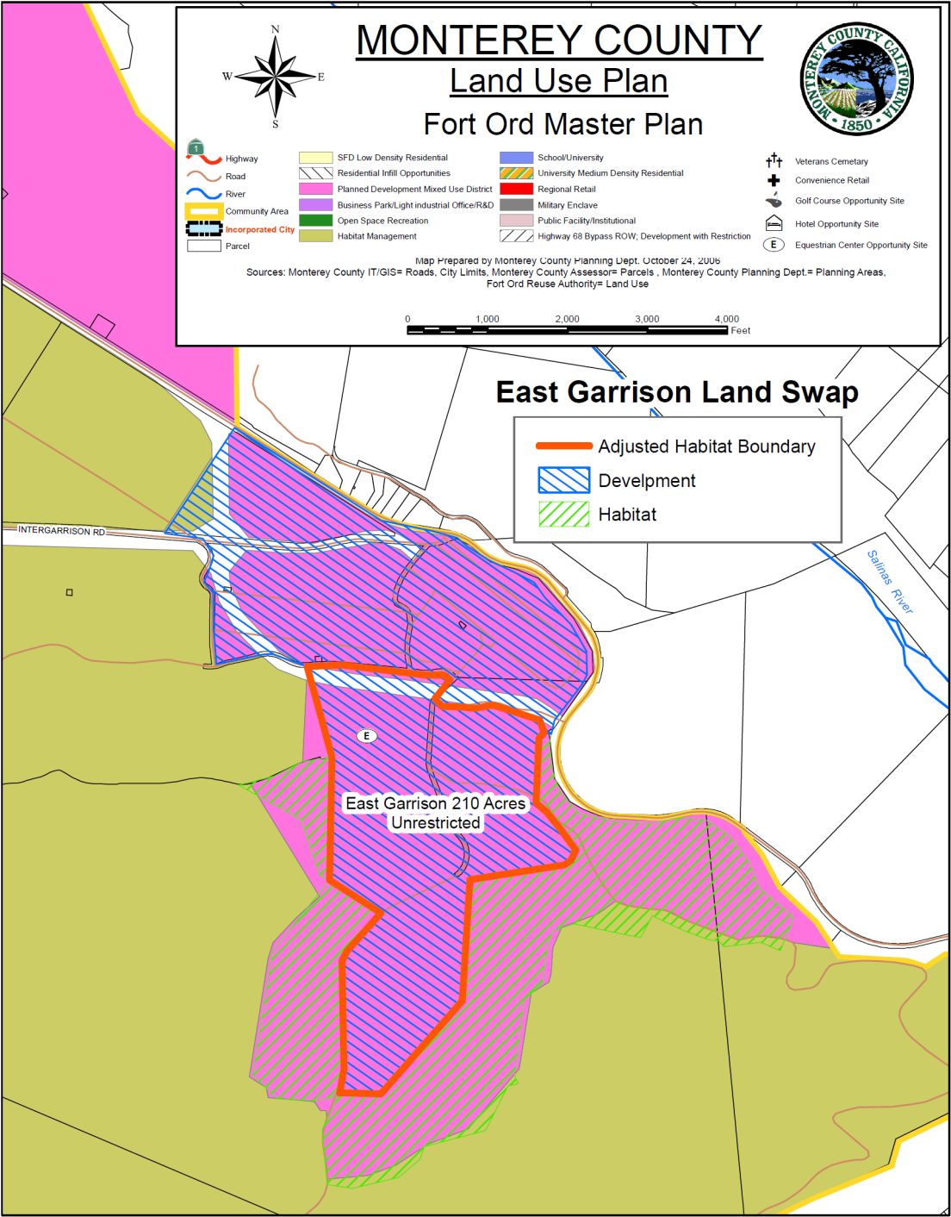
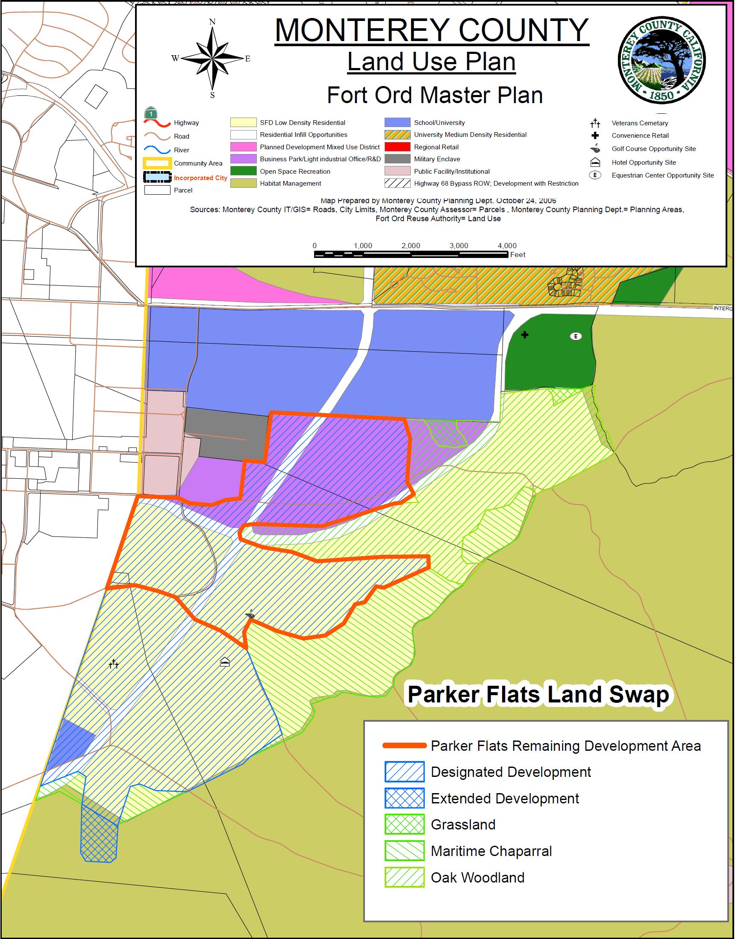
Land Swap Agreement

Slide 7
Water
2010 General Plan amendments
  Long-term sustainable water supply (PS-3.1 and PS-3.2)
  Implement groundwater monitoring requirements
Specific requirements within Fort Ord Master Plan
  Comply with DRMP (Hydrology and Water Quality Program B-1.5) – Water Allocation
Consistent with Reuse Plan water policies

Slide 8
Conclusion
The Fort Ord Master Plan is intended to implement the Base Reuse Plan.
The Fort Ord Master Plan is consistent with the Base Reuse Plan

Slide 9
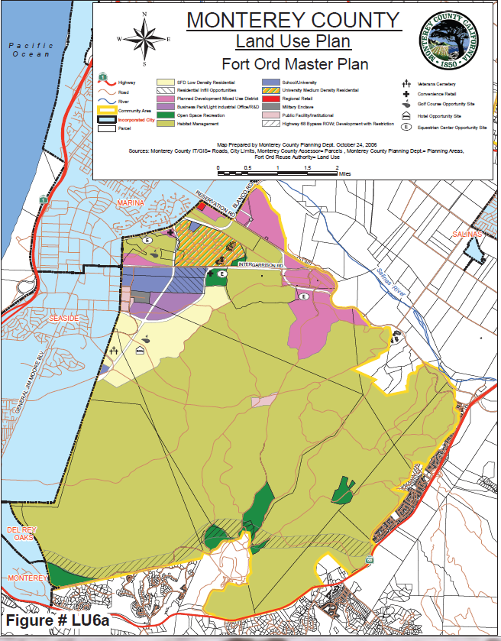
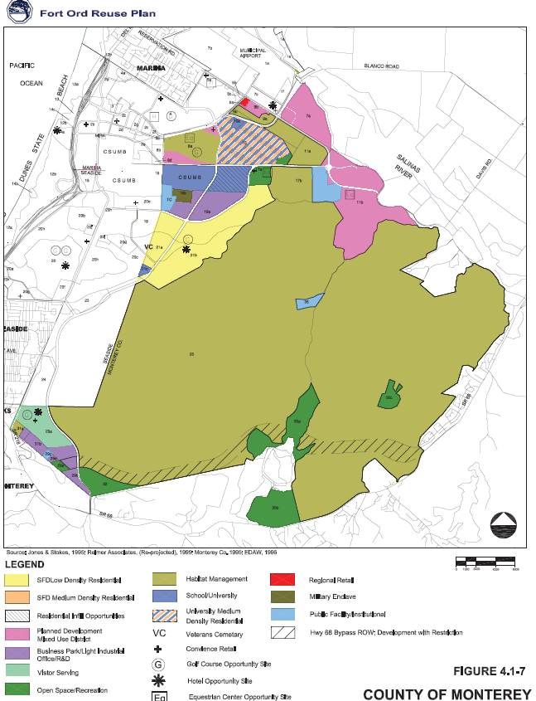
Land Use Map Comparison

